Slide 1
Godot Under the Hood
Led by Samuel O'Sullivan
Assistant Teacher Burnside High School
oss@burnside.school.nz

Slide 2
Godot Nodes and Bolts
Nodes
Scenes
Signals
Animations and Trees
Canvas/Control Nodes
Physics, Collisions and Kinetics
Autoload and Global Variables
Debugging - Remote

Slide 3
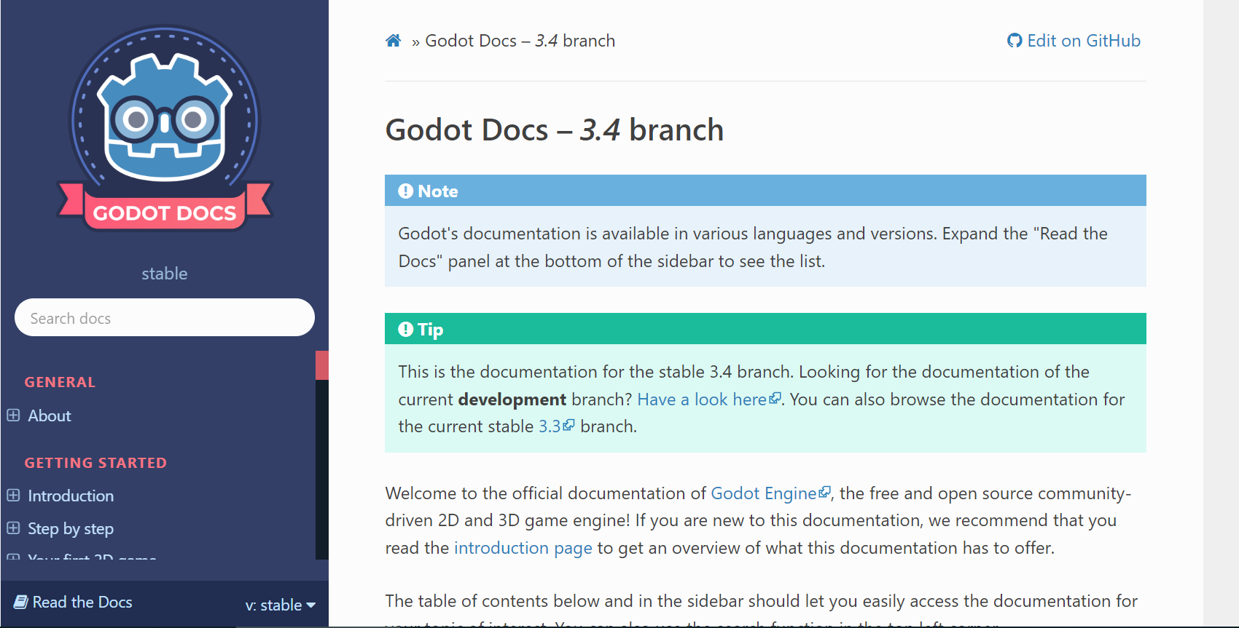
Godot Docs are Amazing!

Slide 4
GDScript
GDScript is a Dynamically Typed language. Very similar to python
https://gdquest.itch.io/learn-godot-gdscript

Slide 5
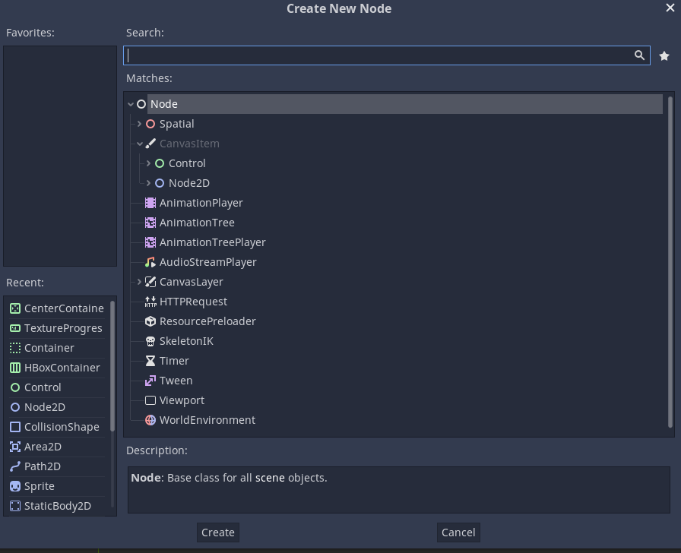
Nodes
Nodes control everything!
Compartmentalise the functions in the game
Know your Nodes
Node Essentials

Slide 6
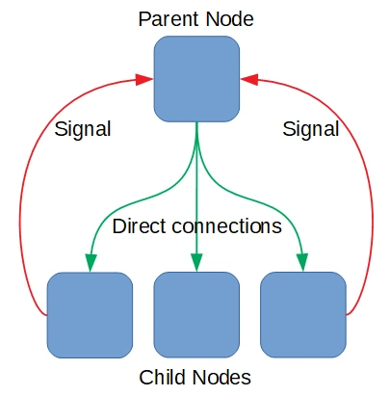
Calling and Signals
Call down, Signal up!
This is a mantra that seriously helps your design from breaking.

Slide 7
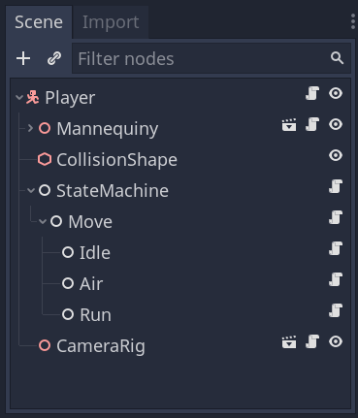
Parents and Children
Godot uses the parent/child system of communication when connecting to other node:
get_parent()
get_child(index)
find_node("node_name")
$”node_path”
$%”node_name”

Slide 8
Calling other Nodes
If you have a node path you can then do lots of awesome stuff like with a:
player_node
You can also then call specific methods:
player_node.take_damage(5)
player_node.get_node(“Sprite”).texture = new_texture

Slide 9
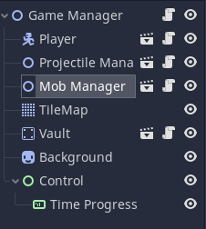
Scenes
Multiple Nodes can be grouped together in scenes (represented by 🎬). This allows you to instantiate things like bullets/enemies/items. But also compartmentalizes code as per best practices.

Slide 10
Managers
Game Manager is the top node and is responsible for handling communication between their children and the other managers
Other manager nodes organize all nodes of the specific type.

Slide 11
Game managers can create some interesting situations
Game Manager
Player
Projectile Manager
Explosion Manager
Enemies Manager

Slide 12
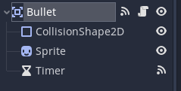
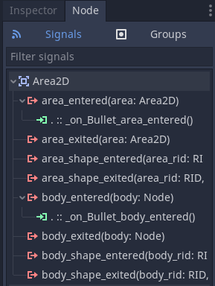
Manually Connecting Signals
Call down, Signal up!
Within the Node you can manually connect signals to methods.
Great for stuff that stays the same

Slide 13
Connecting and Emitting Signals with Code
Great for stuff that doesn't stay the same
signal health_depleted(old_health, health)
func _ready():
self.connect("health_depleted", gameManager, "_on_health_depleted")
func take_damage(amount):
var old_health = health
health -= amount
emit_signal("health_changed", old_health, health)

Slide 14
Physics
Area | They can detect when objects overlap and can emit signals when bodies enter or exit. | Projectiles Hitboxes Anything that needs to detect a collision!
Static Body | Not moved by the physics engine. | Platforms Ground
RigidBody | Implements simulated 2D physics. | Falling objects Interactables
Kinematic Body | Provides collision detection, but no physics. | Players Mobs

Slide 15
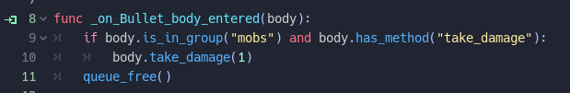
Collision Detection
You will often need to figure out when stuff bashes into each other like projectiles or obstacles.
This can be done with on_body_entered() and on_area_entered().
It is also then useful to check that it is the right body/area.

Slide 16
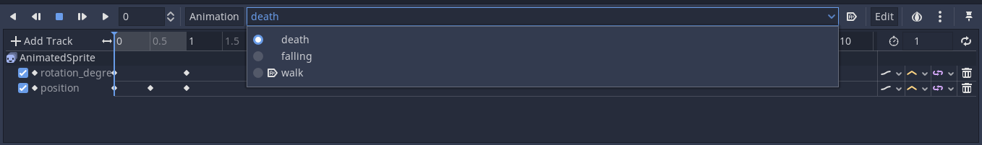
Animations
Animations make everything prettier!
More than that animations in Godot do a lot more than just making things move around the scene…

Slide 17
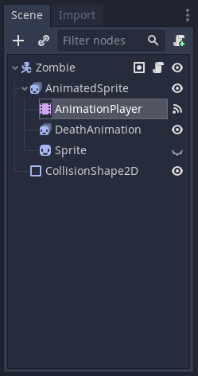
Animations
Animation Player | Allows you to animate almost anything! As well as run functions at specific times and change variables, position, lots of stuff
Animation Tree | Useful for transitioning between different animations
Animated Sprites | Used for 2D animations and spritesheets
Sprites | Normally static sprites but can be useful to turn off and on to achieve certain effects

Slide 18
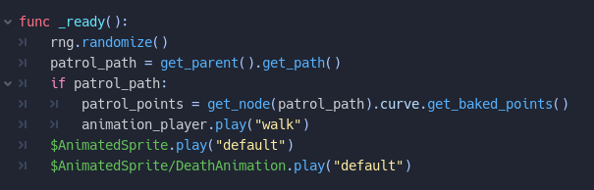
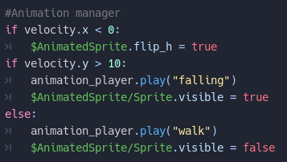
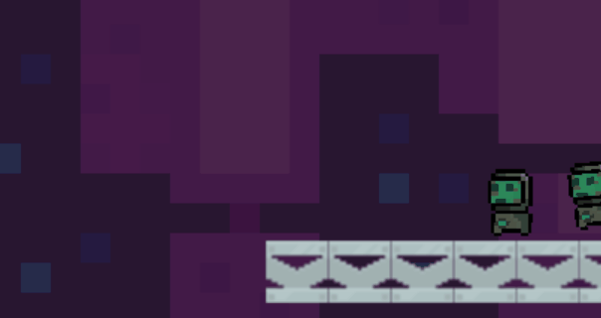
Animations

Slide 19
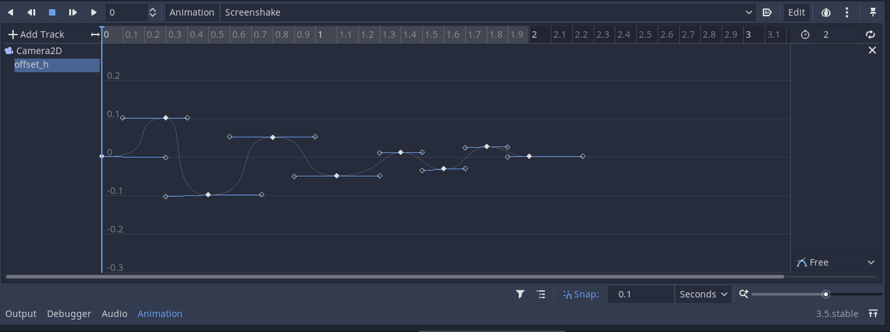
Using animations to do math!
Here I have used a Bezier curve animation to implement screen shake with two lines of code in the script.

Slide 20
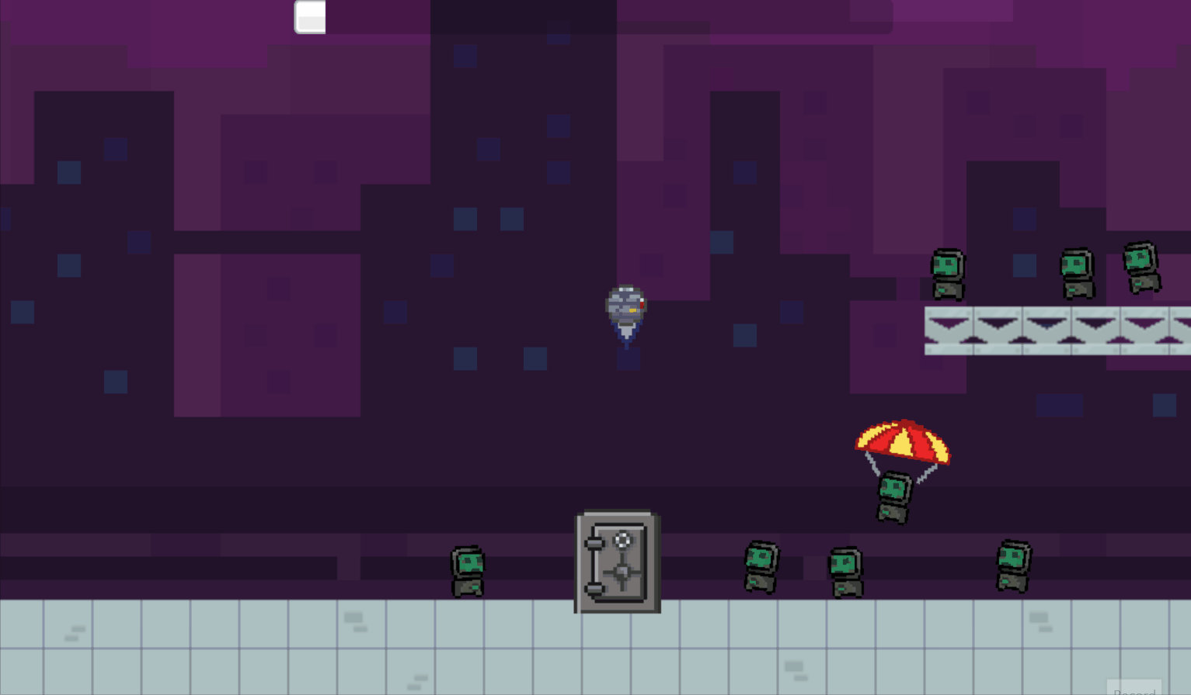
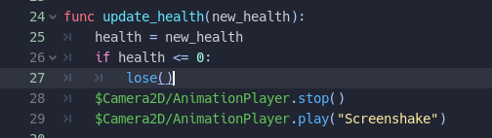
Using animations to do math!

Slide 21
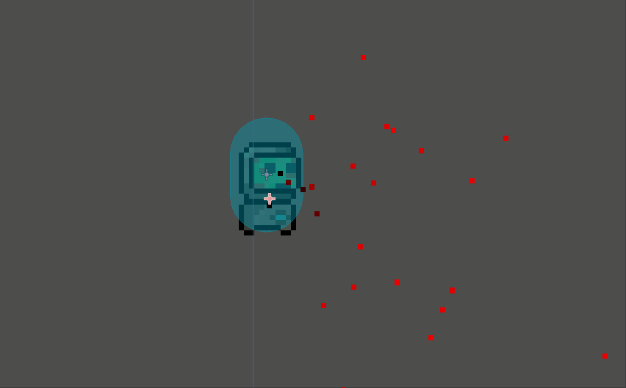
Particle Effects
They are cool!
Made easily in the editor and can see changes in real time!
Make everything awesome!

Slide 22
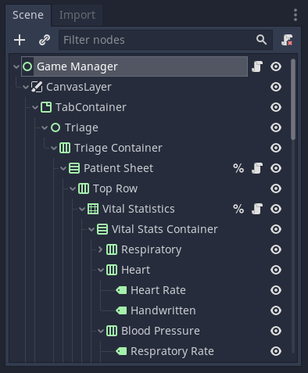
Canvas/Control Nodes
Canvases are used to display UI elements.
The UI layout tools in Godot are… Okay.

Slide 23
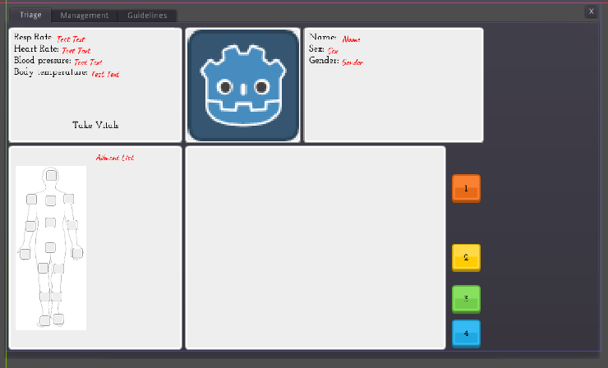
Canvas/Control Nodes

Slide 24
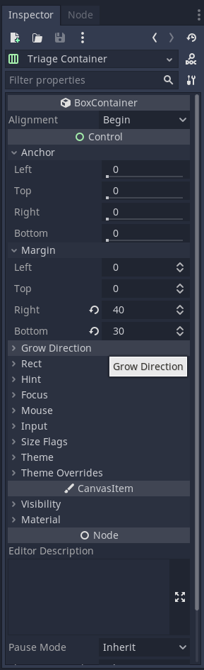
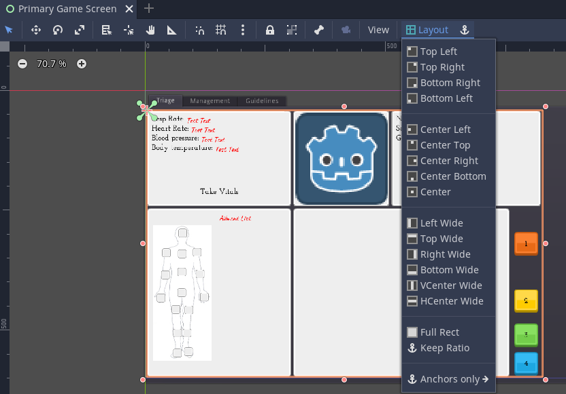
Layout
I primarily use V and H Box Containers to organise game panels. Then it is just a matter of tweaking anchors and margins

Slide 25
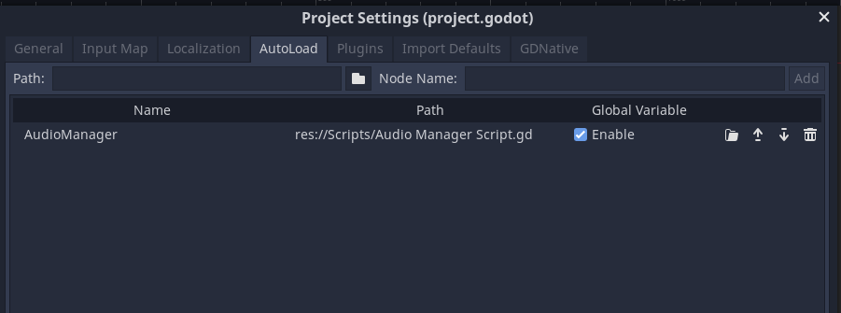
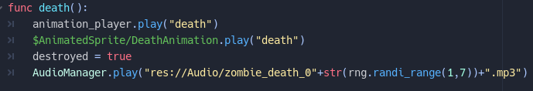
Autoload and Global Variables
Information that needs to be transferred between scenes is often best handled by a Autoload. This gives lots of flexibility in your design.
https://kidscancode.org/godot_recipes/audio/audio_manager/

Slide 26
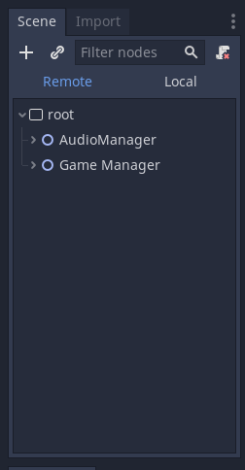
Debugging - Remote
Remote debugging allows you to check on the build in real time and check up on variables.

Slide 27
Final Notes
You don't need to be an expert in everything
+90% of your time is bug finding: checkboxes and code syntax
The only real way to learn is to build stuff
Game Jams are an awesome free way to learn as it gives you a deadline and a goal
Art always takes so much longer than you expect. So I tend to use placeholder art.

Slide 28
How to break your game in one easy step
Move stuff in the File Explorer

